Slide 1

How to Judge
Effectively
Phillip Saurer

Slide 2


Protect Your Senses
DON’T:
Eat spicy/garlic foods
Wear perfume/cologne
Food at judging table
DO:
Breaks
Water
Sensory Resets
Tiny Pours
Notes:
1) Protect Your Senses
► Don’t eat hot, spicy or garlic-heavy foods before you judge. (Preferably 24 hours, more reasonably at least 2 hours.)
► Don’t wear cologne, perfume or other scents.
► Don’t wear lipstick or lip balm - it can interfere with your sense of taste and it will kill the beer’s head.
► Take breaks as needed to refresh your sense of smell and taste, especially when judging strong or hoppy beers.
► Drink water and perhaps chew in a cracker or some bread between beers.
► Sniff something neutral-scented (e.g., your sleeve) to refresh your sense of smell.
► Judge the beer using small (1-2 oz.) samples so you don’t get intoxicated - it can interfere with your senses of smell and taste and it will certainly impair your judgment!
► If you smoke, go far enough outside that smoke doesn’t waft back into the judging area.

Slide 3

Be Polite
Be considerate when writing
Give the type of feedback you would want
Don’t bother other judges
Notes:
2) Be Polite
► Always be polite and objective when discussing a beer or giving feedback. Be considerate of the brewer’s feelings - even the beer you’re judging or writing about is seriously flawed. After all, someone went to a lot of trouble to give you free beer! When you discuss the beer, discuss it as if the brewer was in the room - s/he might be judging at the next table!
► When writing scoresheets, give the sort of descriptions and feedback you’d want to receive yourself - fair, complete and useful. The more information you can provide, the better,
► When you’re done, don’t bother people who are still judging - go elsewhere if you want to talk.

Slide 4
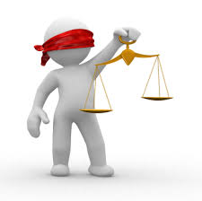
Be Fair
Don’t judge in a category you have an entry in
Don’t guess or assume
If bottle is bad, ask for the second
If beer is completely out of style, talk to competition coordinator
Remain neutral, even if you suspect the maker of the beverage in front of you
Consensus
Notes:
3) Be Fair
► Don’t judge beer in a category you’ve entered. If you’re accidentally assigned to judge a category in which you have entries, tell the judge director so he can assign you to judge another category.
► Don’t Guess. Review the appropriate section of the guidelines before you start judging the flight and consult them as you judge. If you don’t know how to describe something, or if you have a question, ask another judge.
► If you get a bad bottle of beer, ask the stewards to bring out the second bottle. (But sample it sparingly and recap it immediately after your pour it, just in case it wins and has to go on to mini-Best of Show or Best of Show.)
► If you think that a beer has been entered in the wrong category, tell the judge director. He will be able to find out if your suspicions are correct.
► Even if you think you know who brewed a particular beer, remain neutral - don’t let your opinions of the brewer influence your perceptions, scoring or feedback.
► If you can’t reach a consensus with the other judges on a beer’s merits, agree to disagree and move on, or call in the judge director to resolve disputes.

Slide 5

Learn How to Smell and Taste
Sniff
Sip
Linger
PRACTICE!
Notes:
4) Learn How to Smell and Taste
► First, sniff the beer using just your nose. Notice any fleeting aromas. Then hold the glass so that you can inhale the beer’s aroma through both your mouth and nose, so you get the aroma into the back of your mouth and high into your nasal passages.
► Sip the beer so that just a bit gets on your tongue. Note any initial taste sensations. Take another sip and swirl it around in your mouth. Let it sit in your mouth for a couple of second and swallow. Note mouthfeel and any flavors that develop as the beer warms in your mouth.
► Let the flavor linger in your mouth for a few seconds before you take another sip. Notice any lingering flavors or aftertaste.
► Practice using your sense of smell and taste when you’re not judging beer. Savor your food. Stop and smell the flowers. Try to analyze tastes and smells you can’t identify. Imagine different smell and taste combinations. Eventually, you’ll find yourself recalling certain aromas and flavors when you judge beer, which will improve both your perceptions and your descriptions.

Slide 6
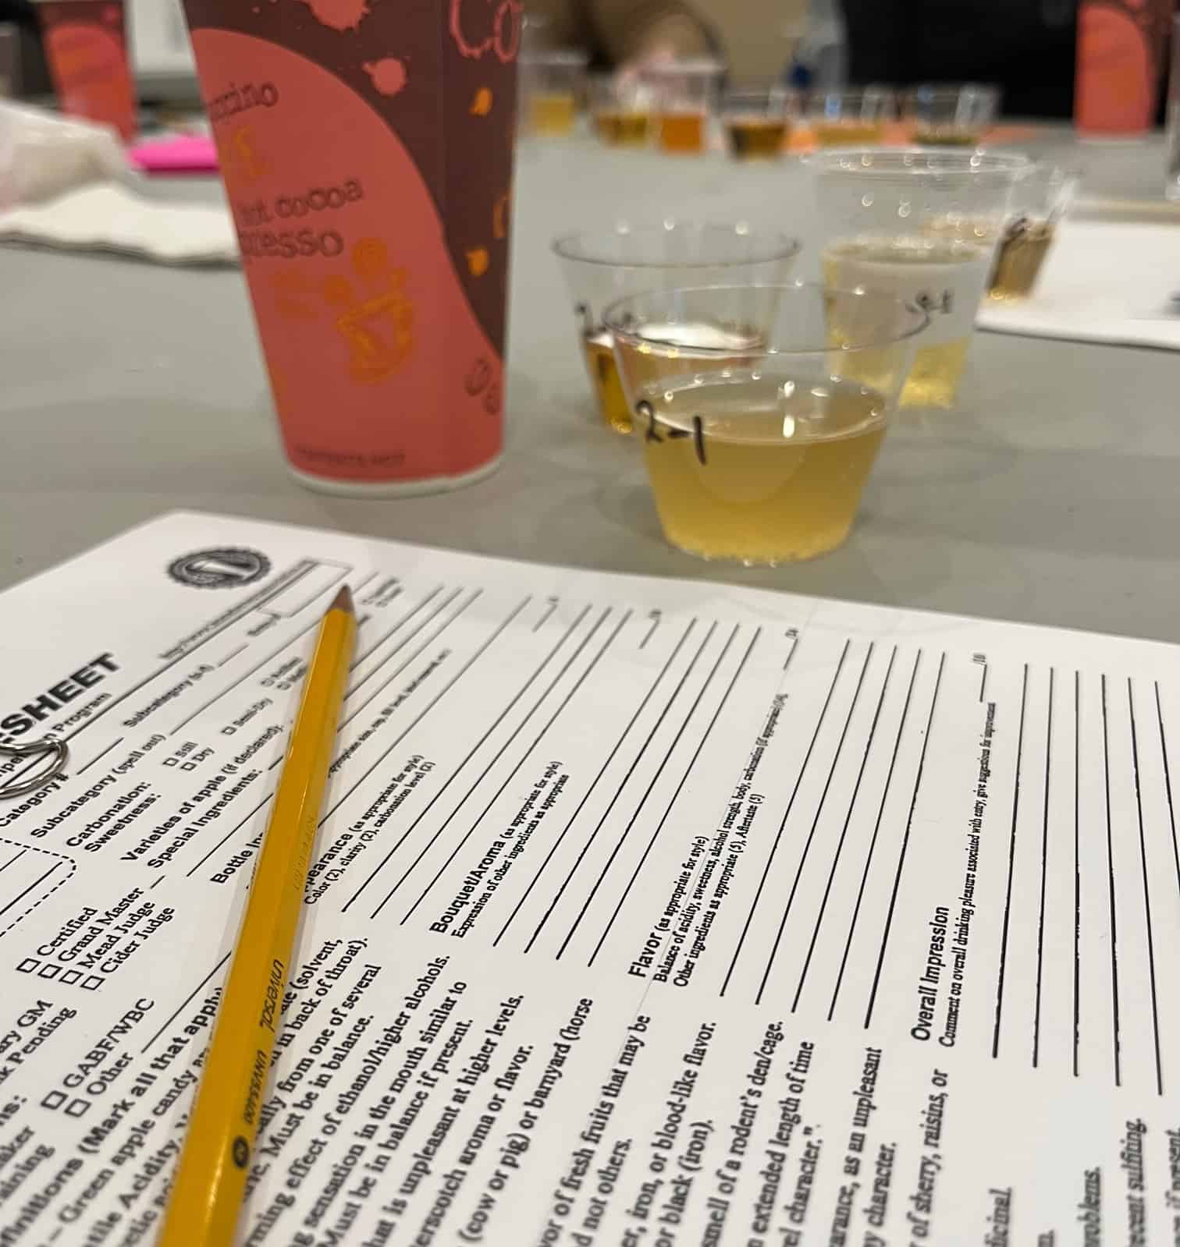
Write a Good Scoresheet
Describe what you smell, see, taste, and feel
  What
  How intense
Don't Rush
Describe the beverage in front of you, not the “style” in front of you
21 Sensory descriptors on a scoresheet, hit them all
Mention what is there, AND what is not there
Describe how it changes over time
Don’t be afraid to make a correction
Notes:
5) Write a Good Scoresheet
► Your description gives the brewer a “snapshot” of what the beer was like on the day of the competition, how well it hit the style guidelines, whether there were flaws, and how good it was. If you do a good job describing the beer, an experienced brewer can use the information to improve his recipe or brewing technique.
► Don’t rush. Take the time you need to do a good job. Fill out the scoresheet completely. Try to write neatly.
► JUST DESCRIBE THE BEER YOU’RE DRINKING. Describe the beer first, and then decide whether it’s to style or if it’s got problems. Don’t assume that some characteristic is, or isn’t, present just because the guidelines say so.
► There are 21 “sensory descriptors” listed on the scoresheet. You should try to mention them all. This means that you should write a minimum of 21 words describing each beer you judge. Remember, “malt” includes base malt and possibly specialty malts, and hops have both bitterness and flavor in the flavor.
► Mention the most important aspects of the beer first.
► Don’t forget to mention the important things that aren’t there. For example, an IPA without bittering hops isn’t much of an IPA!
► Notice how the beer changes as you drink it. Does the head fall quickly? Does haze clear as the beer warms? Do aromas fade out after just a few moments or after a few minutes? Do aromas and flavors develop or fade as the beer stands or warms?
► Use the list of common beer descriptors on the scoresheet as an aid to memory, but don’t assume that every beer will have every descriptor listed, even if it’s badly flawed. Most defective beers just have one or two things wrong with them. Note that the descriptors aren’t necessarily faults! Smooth alcoholic notes in strong beers are often good, as are fruity esters in ales. Remember, the sensory descriptor keywords won’t be on the exam scoresheets, you’ll need to learn to identify and describe them!
► Don’t be afraid to make corrections. The beer might change as it warms or as it lingers in your mouth. Discussion with the other judges might make your realize that your initial perceptions were incorrect.

Slide 7
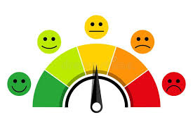
Give Good Feedback
Did you enjoy the beverage?
Is the beer to “style”?
Address the faults, politely.
Try to give 2 points of feedback on how to improve.
More details = better feedback
DON’T ASSUME ingredients or process.
Don’t assume age
If not to “style” describe what style it is presenting as.
If unsure how to fix a flaw, ask another judge
Notes:
6) Give Good Feedback
► Briefly state whether you enjoyed or didn’t enjoy drinking the beer, and how much. A single word like, “Good” or “OK” is fine.
► If the beer isn’t “to style” briefly say so. If it is to style, scoring and feedback will tell the brewer as much.
► Politely address the beer’s faults. Mention the most serious problems first.
► Try to give at least two points of feedback on how to improve the beer. For an amazing beer, one point of general feedback might be all that’s needed, since there’s not much the brewer can do to improve it.
► The more detailed the feedback, the better. If you’re familiar with how the style should be brewed, share brewing tips. For example, instead of “More hops” write, “Add 5-10 IBU for firmer hop bitter” or “Add 1 oz. for 5 gallons of assertive citrusy hop (e.g., Amarillo) 15-20 min. before flameout to get proper hop flavor.”
► Don’t assume that you know how the beer was made. It could be extract or all-grain. It might or might not be dry hopped. In such cases, qualify your feedback. E.g., “If you mash or steep your grains, filter your runoff to keep grain particles from getting into the wort boil.”
► Don’t assume that you know how old the beer is. It could be a decade old but in great condition. It could be a month old but in terrible shape. In such cases, discuss specific faults and qualify your feedback. E.g., “Dark fruit, soy sauce and sherry notes indicate extreme oxidation - either lots of age or severe process faults.”
► Saying what style the beer really is also good feedback. E.g., “Dark amber color, moderate hop bitterness and relatively chewy body make this beer much more like American amber ale.”
► Work with the other judges to give multiple points of feedback, especially when dealing with a badly flawed beer. For example, one judge might address lack of sanitation, while the other writes about ingredient problems.

Slide 8
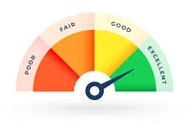
Give an Appropriate Score
Judge to the guidelines, not to what you “prefer”
Don’t rely on memory
Adjust your score as needed
Don’t sweat the score
Be Flexible
Never be afraid to hold your ground on your score
  Be prepared to defend your hill
Notes:
7) Give an Appropriate Score
► Judge according to the style guidelines. Even if you don’t like a particular style of beer, you can still tell if it’s well made and to style. Likewise, even if you love a beer, you can’t give it a high score if it’s not to style.
► Don’t rely on memory. Read the relevant section of the style guidelines before you start judging. Refer to the guidelines, and your description of the beer, as necessary when giving feedback and assigning a score.
► Adjust your score with the other judges so that everyone’s scores are within 7 points of each other. Ideally, you should be even closer than that, at 3-4 points.
► Don’t sweat the exact score unless you think a beer is a potential winner. Focus more on the correct “scoring band” than the exact score.
► Be flexible. If another judge has a score much higher or lower than your own, you might be missing something. Reevaluate your perceptions first, and then defend your score.
► Don’t be afraid to hold your ground. Even as a new judge you bring your own perspective to the judging table. If you’re certain that a particular beer has a fault that the other judges aren’t getting, say so.

Slide 9
Scoring Ranges
13: Minimum Courtesy Score
14-19: Very Bad Beer
20-25: Bad Beer
26-29: Average Beer
30-34: Good Beer
35-39: Great Beer
40-45: Amazing Beer
46-49: Best of the Best
50: God’s own beer
Notes:
Scoring Ranges
Note that these ranges vary a bit from the scoring ranges given on the Beer Scoresheet, but are more typical of the scoring ranges that experienced judges use.
13: Minimum courtesy score; the BJCP version of the Mercy Rule. Only assign this score for beers that are truly undrinkable. (Even then, be polite and try to describe the beer as best you can.)
14-19: Very Bad Beer: Multiple or extremely serious flaws. Very hard to drink. Most really bad beers fall into this range.
20-25: Bad Beer: One moderate flaw or several minor flaws. Hard to drink OR out of style with minor flaws.
26-29: Average Beer: Minor flaw or several trivial flaws. Drinkable, but not great OR great but out of style.
30-34: Good beer. Good homebrew or run-of-the-mill commercial brews. Possibly good enough to get a 2nd or 3rd place finish in small field on a good day.
35-39: Great beer. The sort of beer you’d want to buy. Well-made craft beer. Typical homebrew competition winner. Typical Best of Show contender.
40-45: Amazing beer. A world class beer, worth a special trip. Medal contender in big competitions with lots of entries. Typical Best of Show winner.
46-49: Best of the best. A beer worth planning a vacation to get. Most beer judges can go for years without assigning a score in this range.
50: God’s Own Beer. A beer that’s truly faultless and rocks your world when you taste it. Most beer judges never assign a 50, even if they’ve been judging for decades.

Slide 10

Questions?
Source: 7 Steps to Great Beer Judging

